Slide 1
MH17 MEMORIAL
IJMEER, AMSTERDAM.

Slide 2
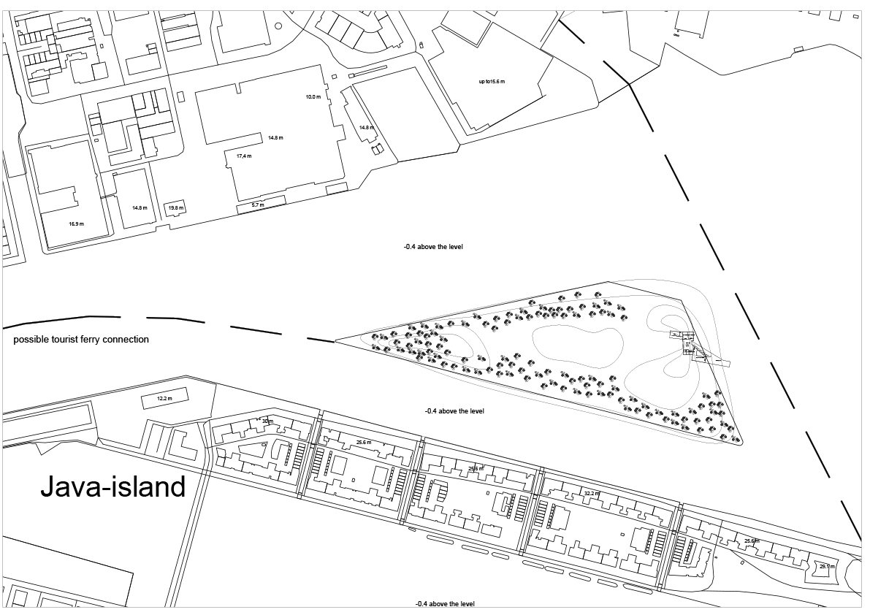
SITE PLAN (NTS)

Slide 3
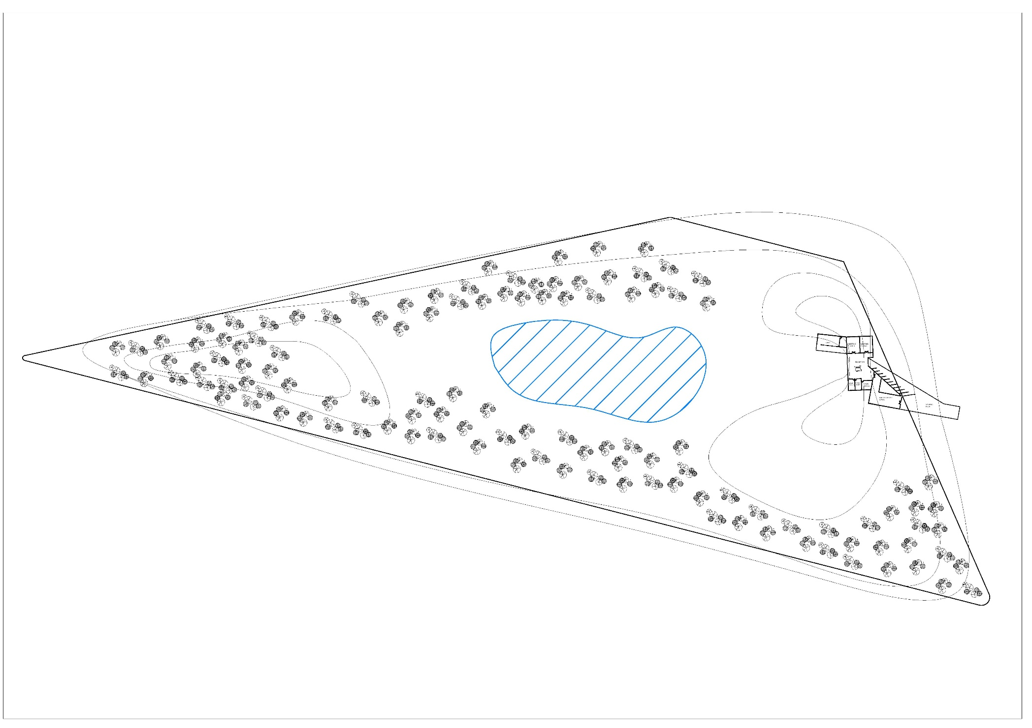
SITE PLAN 1:1500

Slide 4
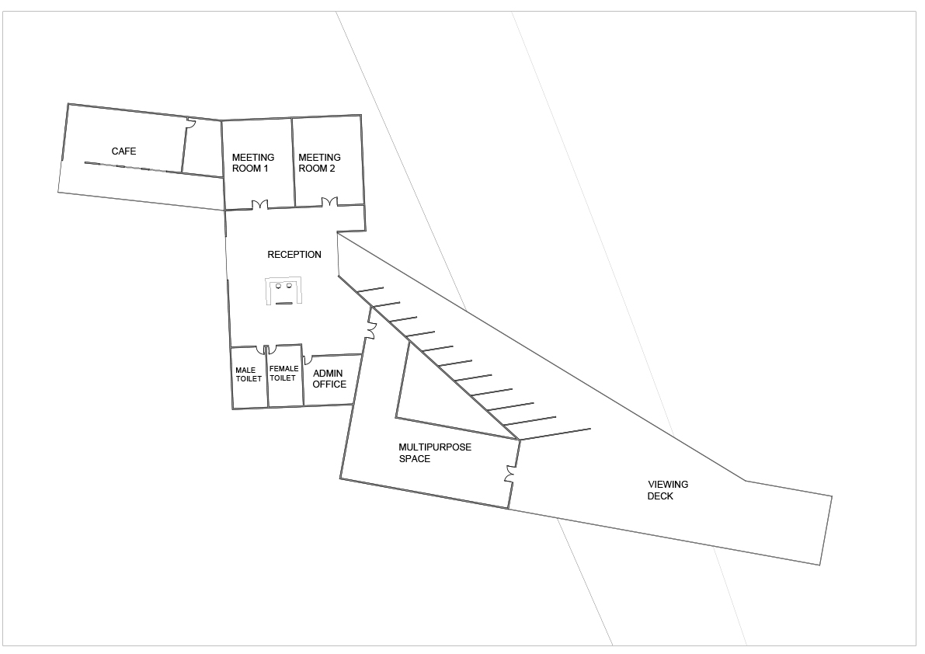
FLOOR PLAN 1:250

Slide 5
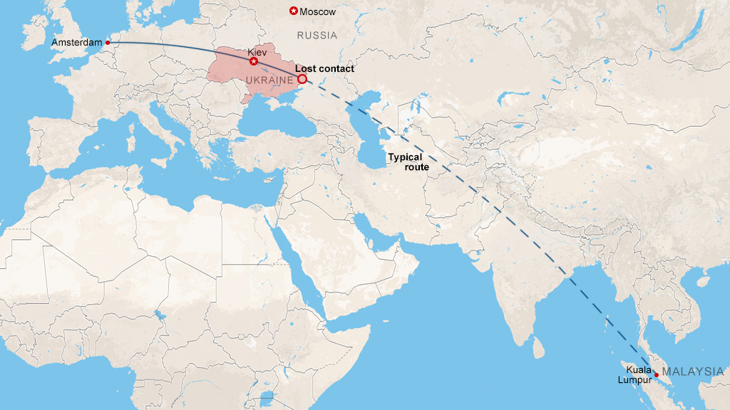


Slide 6
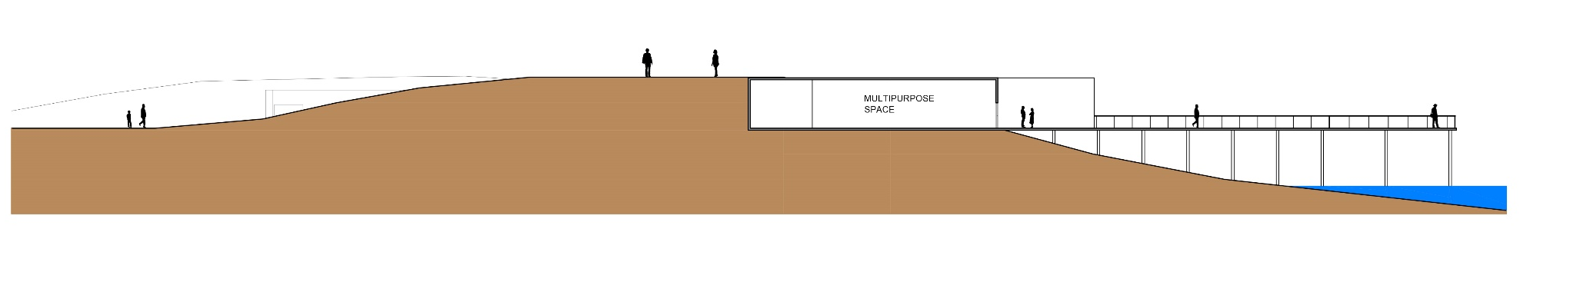
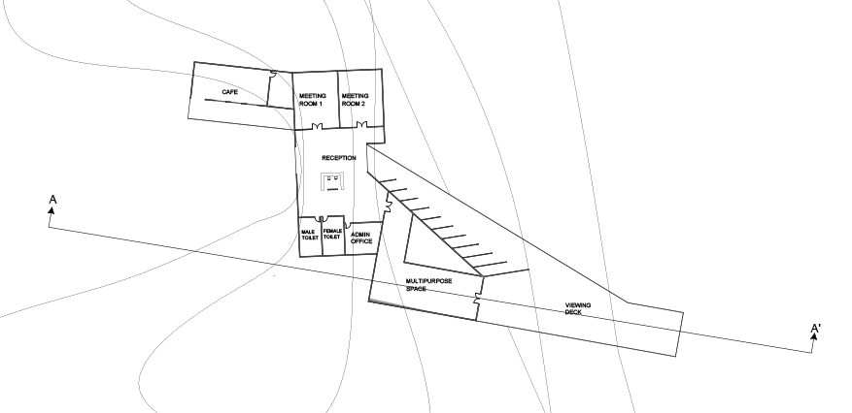
SECTION 1:300

Slide 7
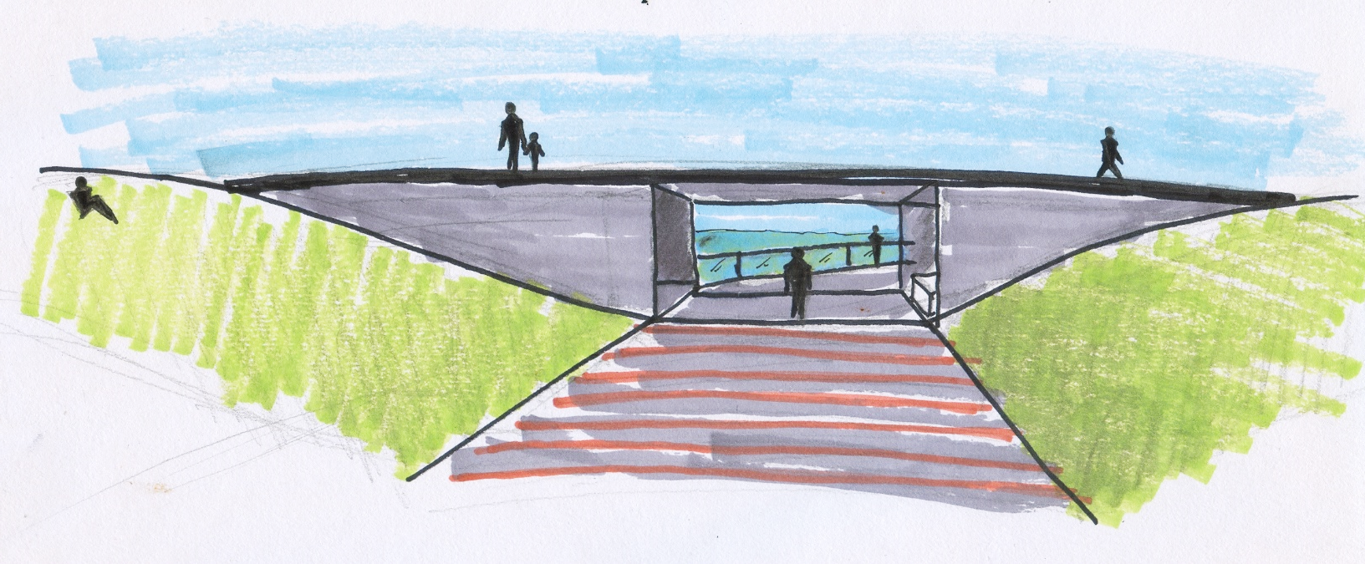
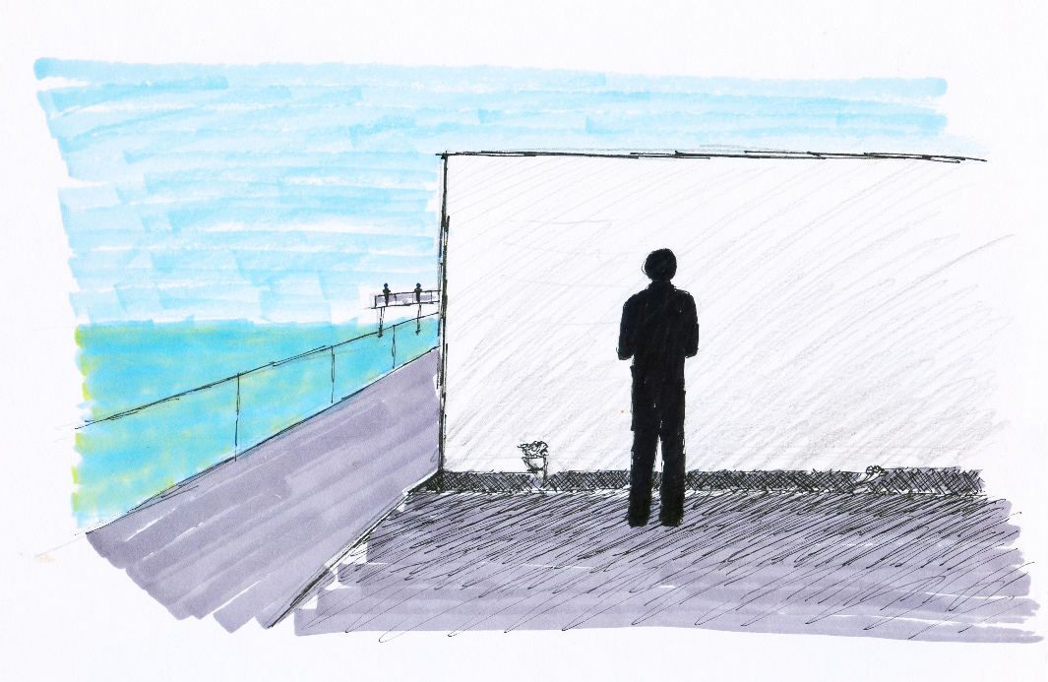
ENTRANCE TO THE MEMORIAL
A MAN MOURNING AT ONE OF THE MEMORIAL WALLS

